Slide 1
The Curious Case of Neural Text Degeneration
Nan An, Yannis Fontaine, Newman Chen

Slide 2
Introduction
Paper Studied: "The Curious Case of Neural Text Degeneration" Authors: Ari Holtzman, Jan Buys, Li Du, Maxwell Forbes, and Yejin Choi Published in 2019.
Context:
Highlights a major issue in text generation: Degeneration (bland, incoherent, or repetitive outputs).
Focuses on problems with maximization-based decoding.
Proposed Solution:
Nucleus Sampling:
Samples from a "nucleus" of top-p probability mass.
Example: With p=90%, it selects tokens covering the top 90% probability.
Comparison to Other Methods:
Outperforms traditional methods like:
Top-k sampling (fixed k tokens)
Beam search (takes most likely sequences)
Greedy decoding (chooses the single most likely token each step)
1/15

Slide 3
Problem and Motivation Setup
Context of the Problem (2019):
LLMs (e.g., GPT-2) were less powerful and widespread.
Degeneration in text generation was a major challenge for models of that era.
Bring nucleus sampling that is an maximization approaches:
Other Method that is using maximization approaches:
Greedy, Beam Search, Sampling (with Temperature), Top-k.
Observed Issues:
Repetition: e.g., repeating the same phrase (positive feedback loops).
Incoherence: drifting off-topic or generating nonsensical content.
2/15

Slide 4
Problem and Motivation Setup
Others methods in details:
Greedy generation
Take most probable token
Sampling (with temperature)
Randomly sample from all the options (with temperature to adjust probabilities)
Beam search
Track a fixed number of ‘most promising’ sequences in a beam shape
Top-k
Sample from just the top k tokens (for a fixed k)
All lead to varying amounts of degeneration
A new method is proposed: nucleus sampling, using the top-p ‘nucleus’ of tokens, which truncates the ‘unreliable’ tail
3/15

Slide 5
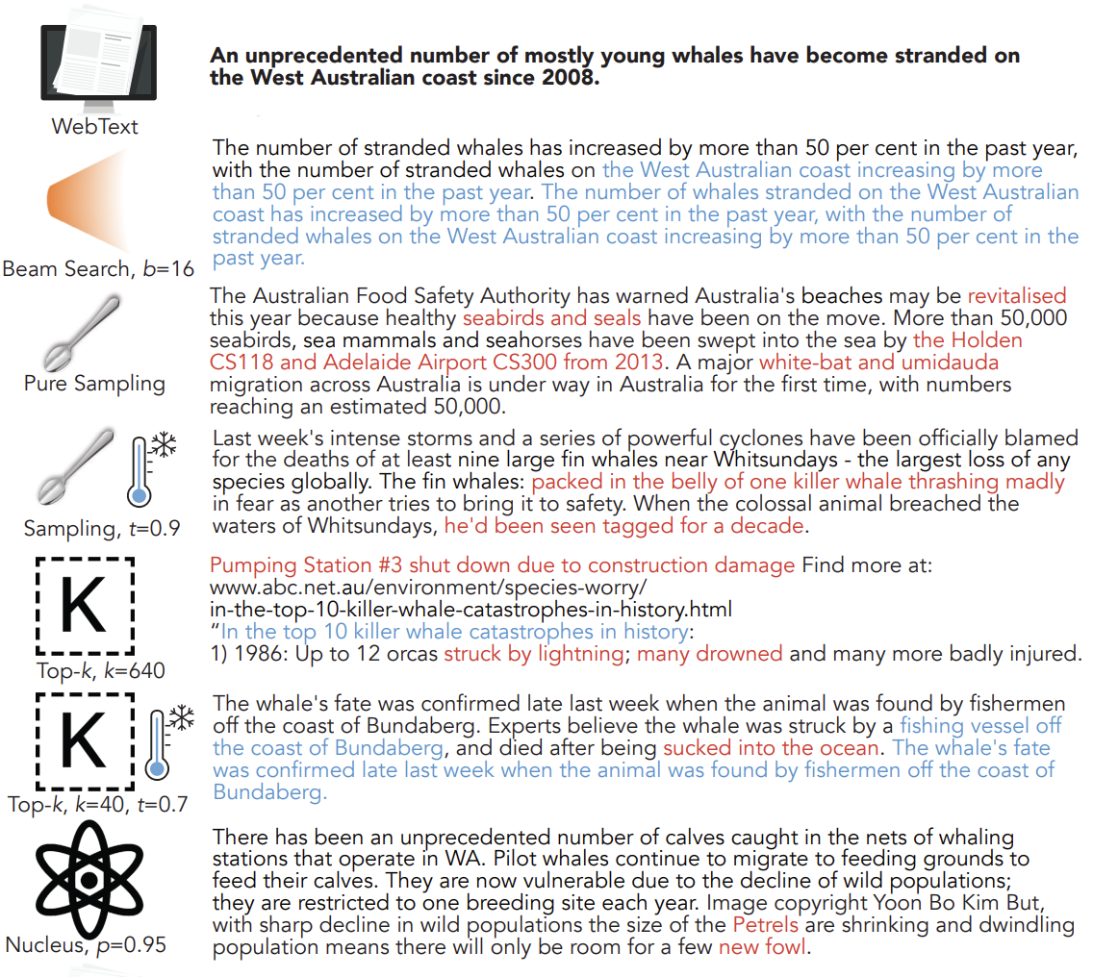
4/15
Notes:
Demonstration of degeneraiton, etc for all methods

Slide 6
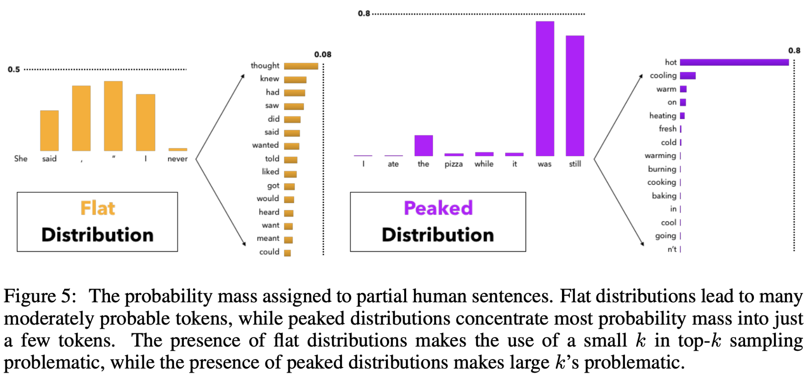
5/15
Notes:
Why nucleus sampling is better than top-k (which is pretty similar)

Slide 7
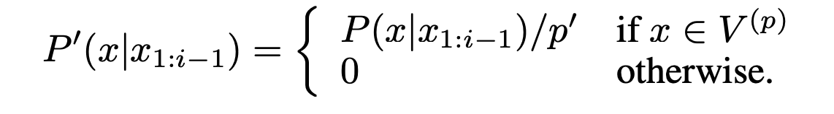
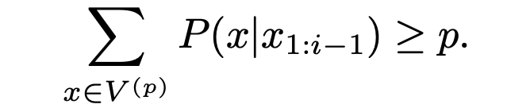
Proposed solution: Nucleus sampling
Key Concept:
Focuses on a dynamic nucleus of tokens representing the top-p probability mass.
Dynamically adjusts the size of the sampling pool based on the shape of the probability distribution.
How It Works:
Probability Distribution Analysis:
Calculate probabilities for all possible tokens at each step.
Truncation:
Select tokens whose cumulative probabilities reach p (e.g., p=0.9).
3. Sampling:
Randomly select the next token only from the truncated nucleus.
6/15

Slide 8
Our overall thoughts on the paper
Overall Assessment:
Effective and focused on an important subject.
Contributed to the field of text generation at a critical time.
Impact Over Time:
Since publication, GPTs and text generation have become more effective and widespread.
The paper's contributions remain relevant and foundational.
Key Strengths:
Clear resolution of a problem (text degeneration).
Clear explanation
Acknowledged Flaws:
Some evaluation metrics and problem explanations could be more robust.
Despite this, the paper is effective overall in addressing its goals.
7/15

Slide 9
Findings of paper
Benefits
Easy to Implement:
A simple and effective technique.
Human-Like Text:
Produces text with a perplexity close to human-written text.
Balanced Output:
Strikes a good balance between quality and diversity.
Limitations
Task-Specific Suitability:
Less effective for tasks needing maximum accuracy (for example: translation)
Parameter Dependency:
Performance depends on calibrating the p threshold for optimal results.
8/15

Slide 10
Relevance and Adoption of Nucleus Sampling
Widely Used in its Era:
Adopted in models of its time, such as GPT-2, for its balance of precision and diversity.
Continued Relevance:
Still applied in modern models where generating human-like, diverse, and coherent answers is crucial.
Key Applications:
Essential for tasks requiring both precision and adaptability, such as:
Chatbots: To generate context-aware and engaging responses.
Content Creation: For diverse and high-quality text generation.
9/15

Slide 11
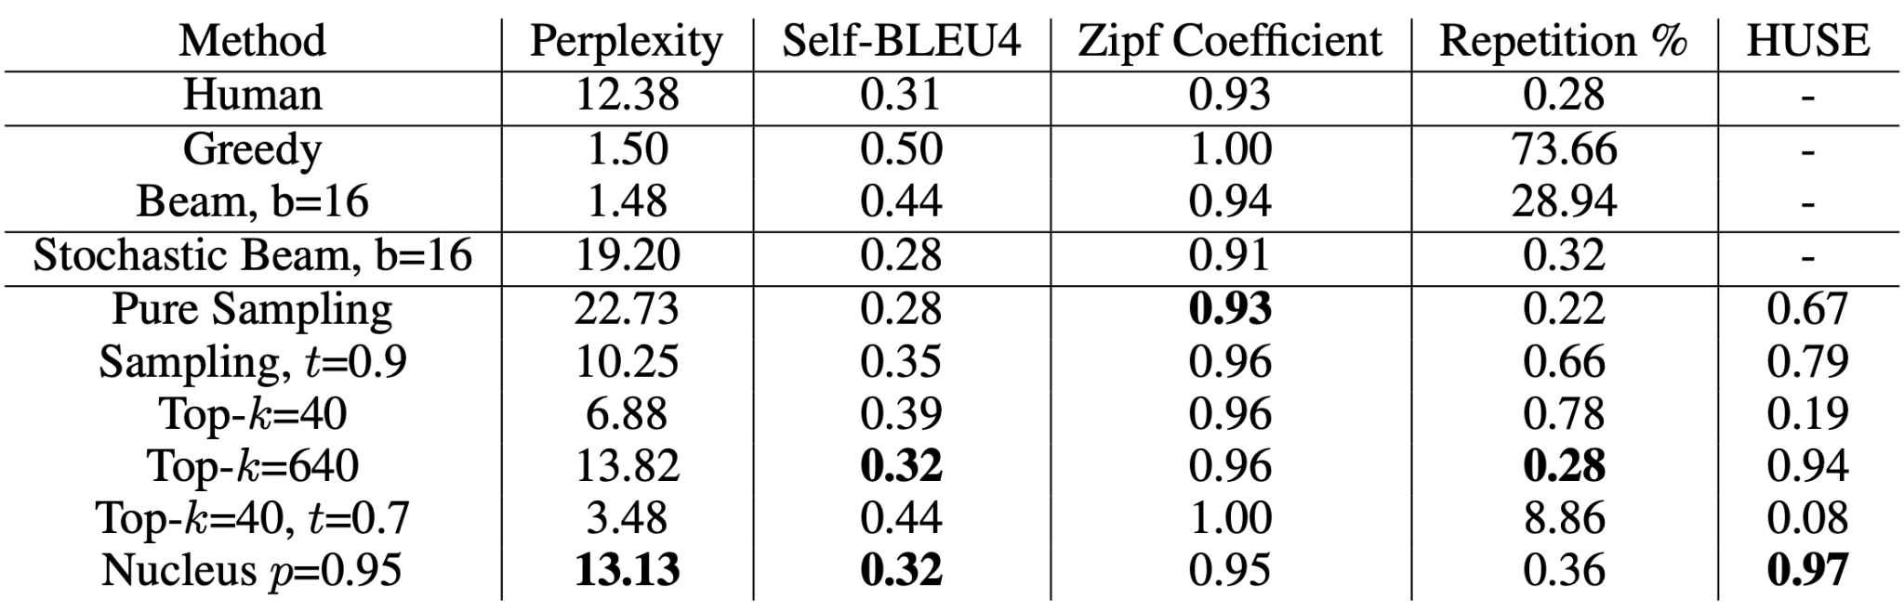
Results
Not necessarily the most ‘conclusive’ / best results, cause some of these are not that well explained with context for what it means
10/15

Slide 12
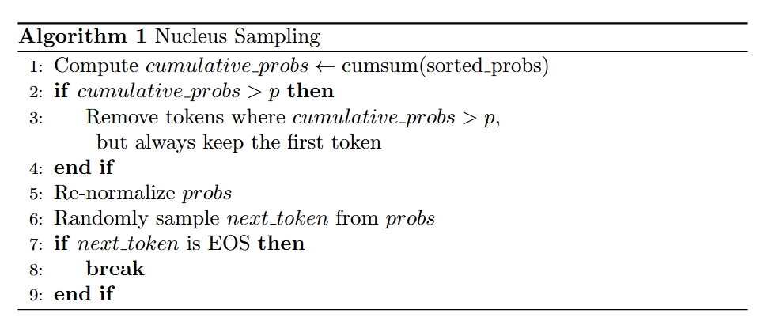
Implement Nucleus Sampling Algorithm
Algorithm ensures that we only sample from high-quality candidates while maintaining diversity.
11/15

Slide 13
Representative Example
Prompt: "Once upon a time"
Threshold (p): 0.85
Maximum Length: 20 tokens
Initial Input: input_ids = [7454, 2402, 257, 640]
Iteration:
Probs = [0.6, 0.3, 0.05, 0.05]
Cumulative_probs = [0.6, 0.9, 0.95,1.0]
Removal Mask: masksorted_indices_to_remove = [False, False, True, True]
Shifting one position: sorted_indices_to_remove = [False, False, False, True]
Re-normalizes: probs = [0.6, 0.3, 0.05, 0.0] to [0.632,0.316,0.053, 0.000]
Sampling the Next Token: Weighted random sampling from three possible token
Update Sequence:Append the new token at the end.
Stopping: Maximum length is reached or an EOS token is sampled.
12/15

Slide 14
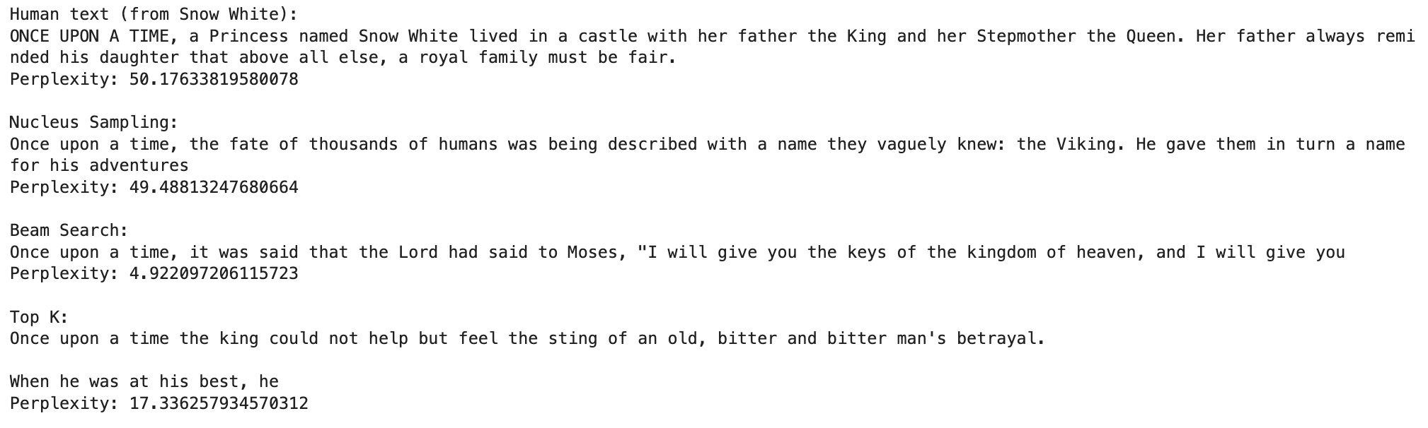
Our experiments
Comparison of perplexity with Prompt :
“Once upon a time”, for the human text we used a start of a fairy tale
13/15

Slide 15
Our experiments
Implementation of Nucleus Sampling and Beam Search to compare.
Example of generation:
14/15

Slide 16
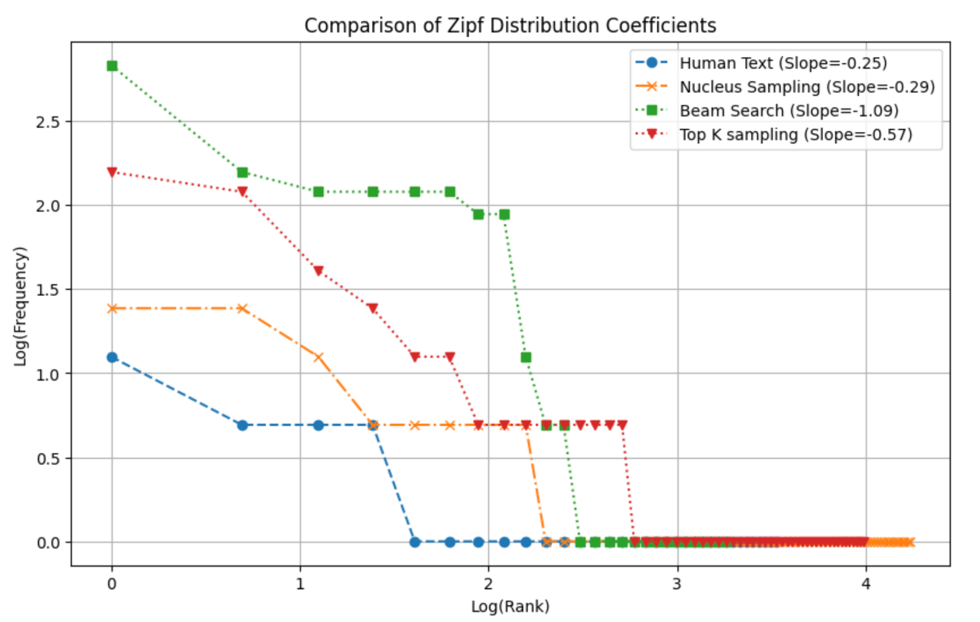
Our experiments
Comparison of Zipf Distribution
We select sentences from fairy tales, such as 'Cinderella Story' to represent human text.
15/15

Slide 17
Thank you for listening

